Slide 1


MACHINE LEARNING BASED EFFICIENT RECOMMENDATION MODEL FOR
DIET PLANNING OF HUMANS
Under the Supervision of
Mr. Atul Barve
Sr Asst Professor at PIEMR
In the
Department of Computer Science & Engineering
Prestige Institute of Engineering, Management & Research, Indore
Session: July-Dec 2024
Project Group
5th Sem (C)
Saniya Tripathi
Sakshi Yadav
Insha Khan
Rishi Vyas
Zaid Ullah
Yash Pathak
Riya Choudhary
SUBMITTED BY-SANIYA,SAKSHI,INSHA,RISHI,ZAID,YASH,RIYA

Slide 2
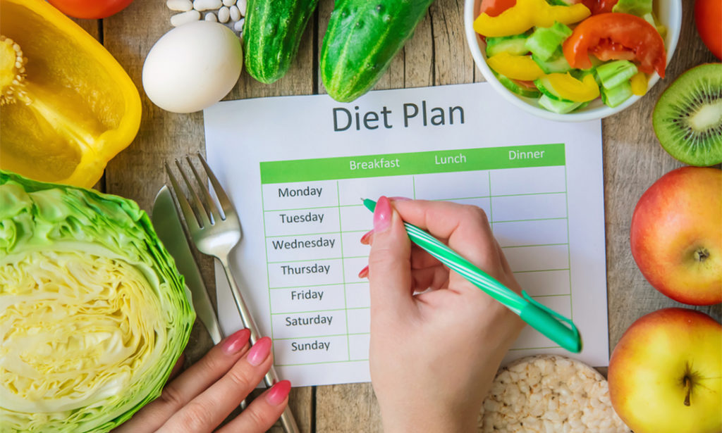
Content
Introduction
Literature Review
Methodology
Project Progress
Future Work
Applications/Use case
Expected Outcome
Conclusion
2
SUBMITTED BY-SANIYA,SAKSHI,INSHA,RISHI,ZAID,YASH,RIYA

Slide 3
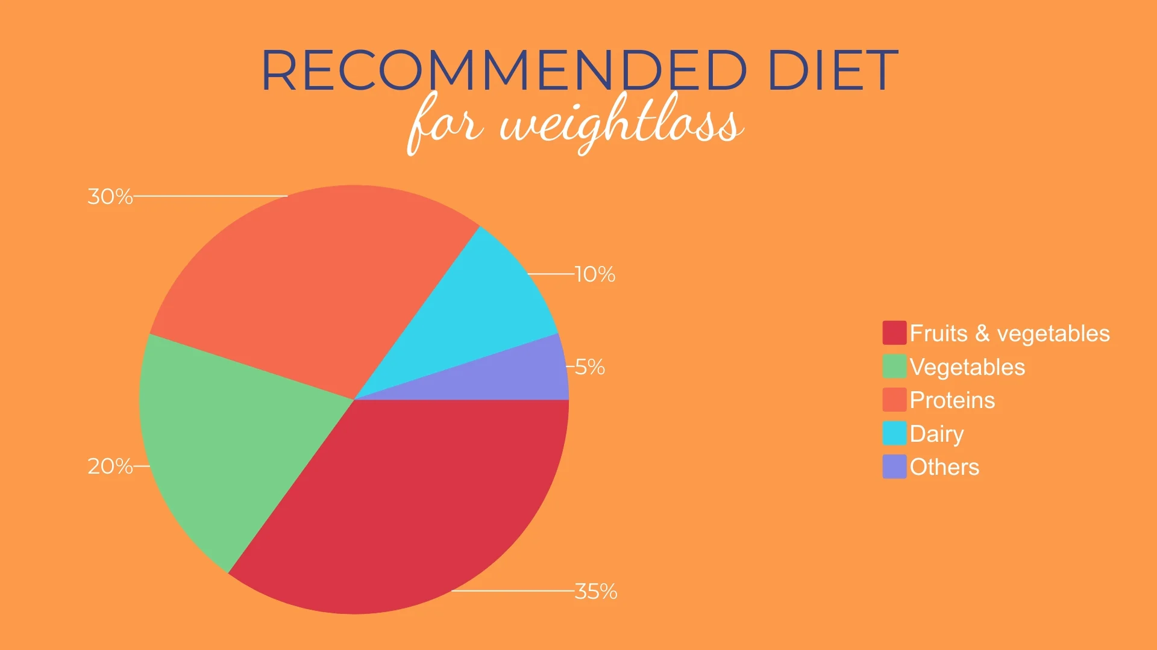
Introduction
Problem Statement:
Need for Personalized Diet Plans:
Existing Solutions Are Generic and lack customization.
Objective of the Project:
Develop a machine learning model to provide tailored diet recommendations
Analyze health data (age, weight, medical conditions).
Provide flexible diet plans adaptable to individual health needs
SUBMITTED BY-SANIYA,SAKSHI,INSHA,RISHI,ZAID,YASH,RIYA

Slide 4
Scope of the Project :
Target Users:
Focus on individuals with chronic diseases (e.g., diabetes, obesity).
Customization:
Ability to customize diet plans according to user preferences and lifestyle.
SUBMITTED BY-SANIYA,SAKSHI,INSHA,RISHI,ZAID,YASH,RIYA

Slide 5

Literature Review
Existing Solution/Technologies:
Diet Apps: Many apps suggest meals based on calories (e.g., MyFitnessPal).
Machine Learning: Some use algorithms And give personalized suggestions.
Gaps Identified:
Not Personalized: Most apps give general advice instead of tailored plans.
Limited Data Use: Few apps combine different health info to make better plans
SUBMITTED BY-SANIYA,SAKSHI,INSHA,RISHI,ZAID,YASH,RIYA

Slide 6



Methodology
Tools/Technologies/Frameworks being used:
Languages: Python for data work.
ML Libraries: Flask, Numpy , Pandas ,Scikit-Learn and many more libraries are used.
Frontend: HTML, CSS for UI design.
System Architecture/Design Diagram/Flow Diagram:
User Input: Users enter their information (age, weight, preferences).
Data Processing: The system gathers and analyze this information.
Recommendations: It suggests personalized meal plans.
Output: Users see their diet suggestions
SUBMITTED BY-SANIYA,SAKSHI,INSHA,RISHI,ZAID,YASH,RIYA

Slide 7
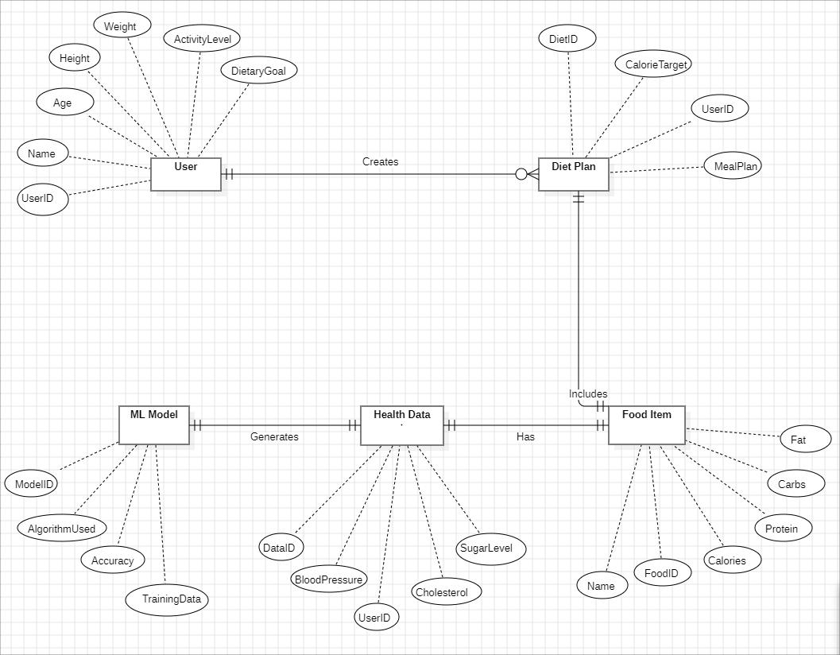
ER-Diagram
SUBMITTED BY-SANIYA,SAKSHI,INSHA,RISHI,ZAID,YASH,RIYA

Slide 8
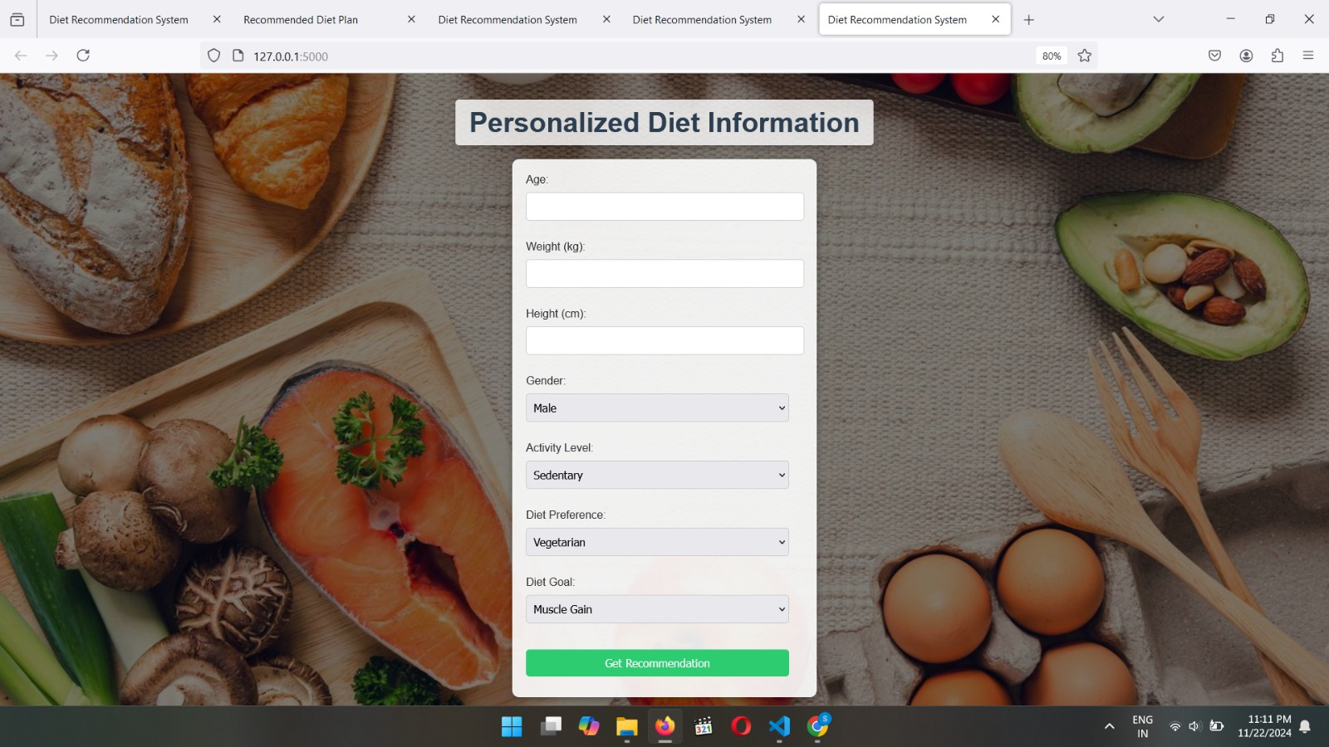
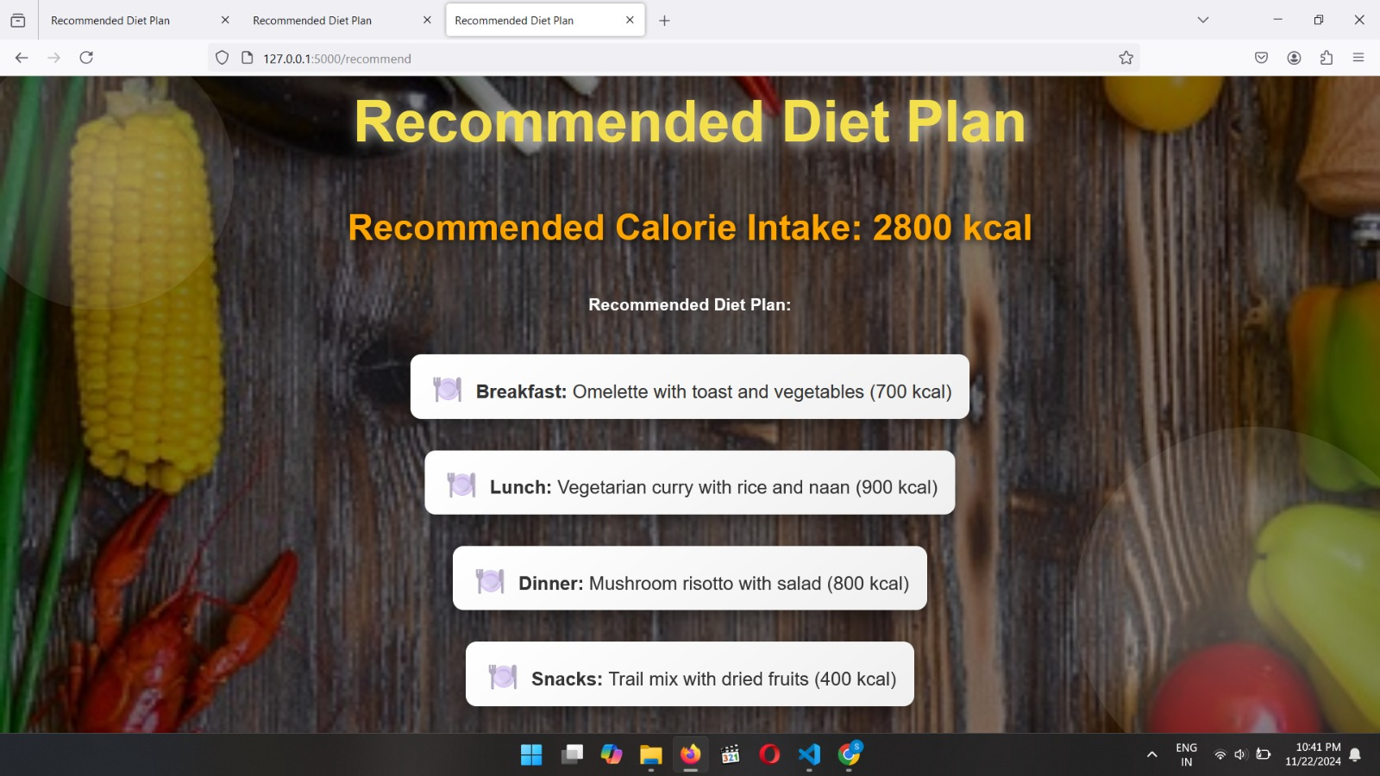
Prototype
SUBMITTED BY-SANIYA,SAKSHI,INSHA,RISHI,ZAID,YASH,RIYA

Slide 9
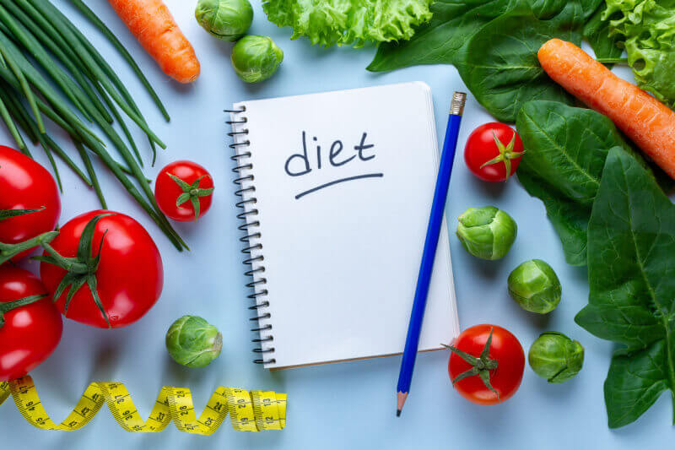
Project Progress
Modules Completed:-We gathered information about food and nutrition to make personalized diet suggestions, We collect user details like age, health, and goals to give personalized advice.
Work in Progress (current status):- We are training the system to make more accurate recommendations using real-world data and model ready to give diet plans.
Features Implemented/Functionalities Developed:-The system creates diet plans based on personal needs, like losing weight or building muscle.
SUBMITTED BY-SANIYA,SAKSHI,INSHA,RISHI,ZAID,YASH,RIYA

Slide 10
Future Work
Feature Improvements:Adding multiple dietary preferences (e.g., vegan, gluten-free, keto)
Research and Development:Keeping the recommendations updated with the latest dietary research.
Creating a more advanced and user-friendly website in the future with multiple options and improved UI for a better user experience.
SUBMITTED BY-SANIYA,SAKSHI,INSHA,RISHI,ZAID,YASH,RIYA

Slide 11
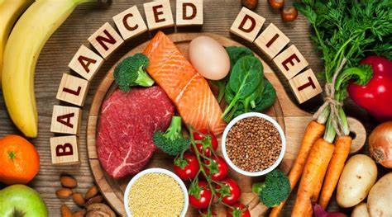
Applications/Use Cases
Personalized Nutrition Plans
What It Does: Machine learning helps create meal plans that are customized for each person.
How It Works:
It looks at your personal details like age, weight, health goals, and food preferences.
It then recommends meals that suit your body and lifestyle.
Example: If you are trying to lose weight, it suggests low-calorie meals and adjusts your plan if you aren't seeing progress.
SUBMITTED BY-SANIYA,SAKSHI,INSHA,RISHI,ZAID,YASH,RIYA

Slide 12
Supporting Fitness Goals
What It Does: Machine learning helps people who exercise by giving meal plans that boost energy and help recovery.
How It Works:
It looks at your exercise routine and recommends meals to give you more strength or help you recover faster.
Example: A runner gets high-energy meals before a race and protein-rich meals afterward to build muscles.
SUBMITTED BY-SANIYA,SAKSHI,INSHA,RISHI,ZAID,YASH,RIYA

Slide 13
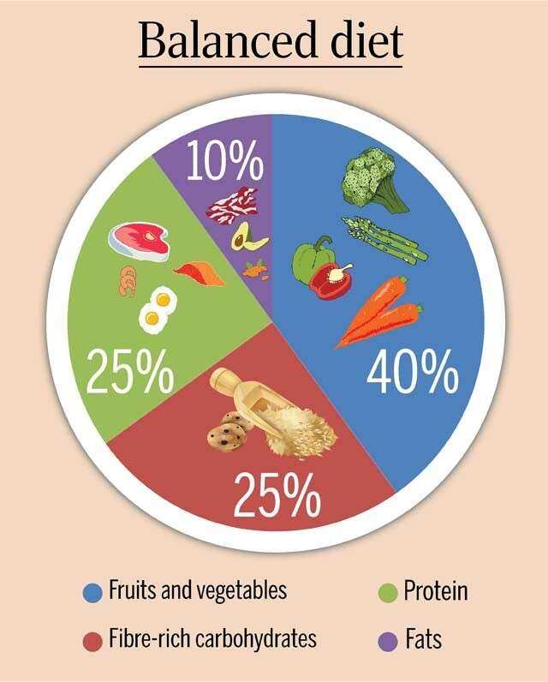
Expected Outcome
Healthier Eating Habits
Personalized meal plans encourage better food choices, helping users maintain a balanced diet and achieve their health goals.
Better Management of Health Conditions
Tailored diets help manage conditions like diabetes, heart disease, and obesity, improving overall health and reducing complications.
Improved Fitness Results
For athletes and fitness enthusiasts, diet recommendations support better performance, faster recovery, and muscle building.
SUBMITTED BY-SANIYA,SAKSHI,INSHA,RISHI,ZAID,YASH,RIYA

Slide 14
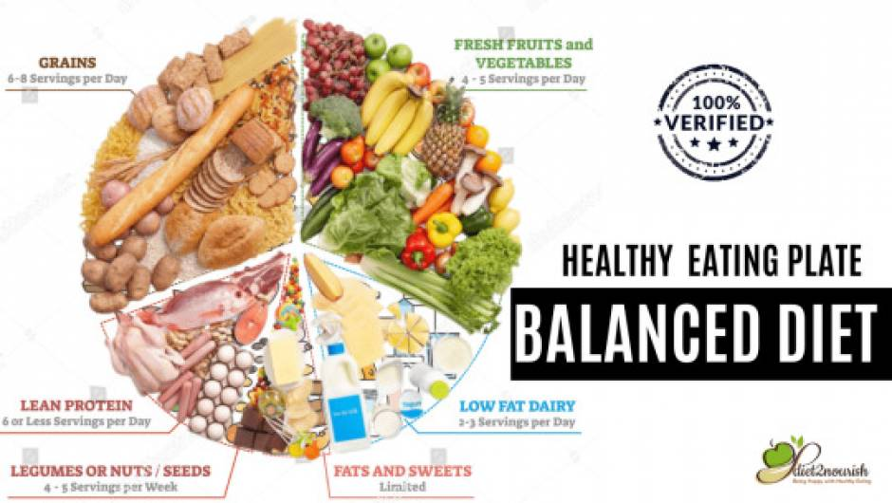
Conclusion
Personalized nutrition for everyone
Machine learning makes it possible to create meal plans that are tailored to each person’s unique needs, preferences,
and health goals.
Better health and fitness
From managing chronic conditions to boosting fitness performance, diet recommendation models can make a big
difference in people’s lives.
Adapts and learns
These systems get smarter over time, adapting to changes in lifestyle, health data, and user feedback,
making their recommendations more effective.

Slide 15
References
REFERENCE :Smith, A. (2020). Personalized nutrition guidance through diet recommendation systems. Journal of Health Technology.
Jones, L., & Brown, M. (2019). Integrating diet recommendation systems into healthcare: Considerations for practitioners. Nutrition Today.
Smith, A. J., & Johnson, L. M. (2018). Personalized diet recommendation system: A mobile app approach. Journal of Health Informatics.
Smith, J. R. (1994). NutriGenie: A computer-based nutrition analysis and management program. Journal of Health Software.
Patel, S. R., & Brown, E. C. (2019). Factors influencing user acceptance of diet recommendation systems: A qualitative study. Health Informatics Journal.
SUBMITTED BY-SANIYA,SAKSHI,INSHA,RISHI,ZAID,YASH,RIYA

Slide 16
Queries/Questions?
SUBMITTED BY-SANIYA,SAKSHI,INSHA,RISHI,ZAID,YASH,RIYA

